Slide 1
Kamyab Zamindar: SOIL MONITORING SYSTEM FOR EFFICIENT IRRIGATION Project Proposal Defense
Group Members:
Syed Mohsin Shah 19PWCSE1749
Muhammad Waleed 19PWCSE1786
Muhammad Ali 19PWCSE1801
Supervisor:
Dr. Salman Ahmed

Slide 2
Presentation Outline
1. Problem Statement
2. Linkage of FYP with UN SDGs
3. Mapping and Justification of FYP with 5 Courses
4. Societal Impact
5. Expected Outcome

Slide 3
Problem Statement
About 40% of the earth's land is now given over to agriculture
it consumes 85% of available fresh water.
due to population growth this figure has been increasing every year
a major challenge to every nation for reducing the farm water consumption.
How to design an efficient soil monitoring system for better management of water resources to reduce water usage?
Reference: Matti Satish Kumar, T Ritesh Chandra, D Pradeep Kumar and Dr. M. Sabarimalai Manikandan, Monitoring moisture of soil using low-cost homemade Soil Moisture Sensor and Arduino UNO 2016 3rd International Conference on Advanced Computing and Communication Systems (ICACCS-2016), Jan-22&23,2016, Coimbatore, INDIA.
Slide # 3 /7

Slide 4

Linkage of FYP with UN SDGs
End hunger, achieve food security and improved nutrition and promote sustainable agriculture
Sustainable agriculture through efficient crop management system
Regulated supply of water

Slide 5
Mapping of FYP with 5 DCSE Courses
S. No. | Course Code | Course Name | Justify the linkage with FYP
1. | CSE-307 | Microprocessor Based System Design | For controlling hardware devices and sensors.
2. | CSE-103 | Circuit & Systems I | Creating the circuitry of the desired system.
3. | CSE-303 | Data Communication & Networks | For configuring different network protocols.
4. | CSE-102 | Computer Programming | Programming the End-app and also the MCU.
5. | CSE-309 | Signal and Systems | For analysis of signal generated from MCU.

Slide 6
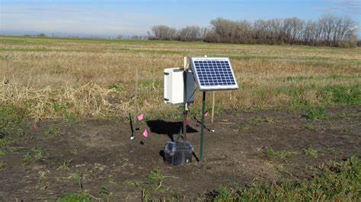
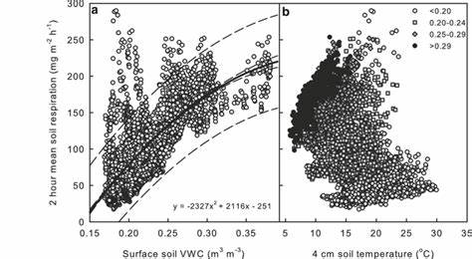
Societal Impact
Farmers will have a more efficient system to monitor their
irrigation by avoiding excessive or immoderate usage of water.
Ensure availability and sustainable management of water
for the community.

Slide 7
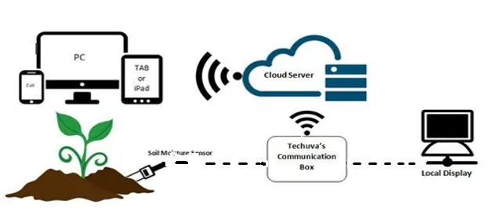
Expected Outcome
An IoT based system for Soil Monitoring
Hardware Project
Figure 1. Proposed Sketch

